Slide 1
Employee Management
Name: Anubhav
Emp Id: 206590

Slide 2
Project overview
Purpose: To manage employees records using command line
Key Features:
Employee Registration: Employees can register themselves on the portal using cmd.
Employee Login: Registered Employees can login to see their details.
Update Employee Details: Registered Employees can updated their details.
Delete Employee: Employees can delete their profile from the system.

Slide 3
Workflow
Registration: Employees can register in the system by providing their details through a command-line interface (CLI). Input Fields: First Name, Last Name, Joining Date, Location, Salary, Currency (USD, INR), Password.
Login: Registered employees can log in using their id and password. The system checks if the entered employee id and password combination matches a record in the database. If the credentials are valid, the employee gains access to the system. Failed login attempts are handled with error messages.
Update Employee: Once logged in, employees can update their profile information.
Remove Employee: Employees have the option to delete their accounts from the system.

Slide 4
Database schema
create table if not exists employees (
id serial primary key,
first_name text not null,
last_name text not null,
joining_date date not null,
location text not null,
salary int not null, -- (monthly salary)
currency text not null,
password text not null
);

Slide 5
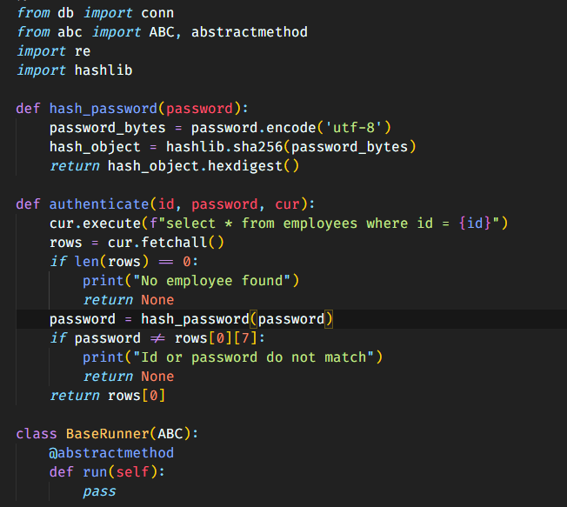
ScreenShot

Slide 6
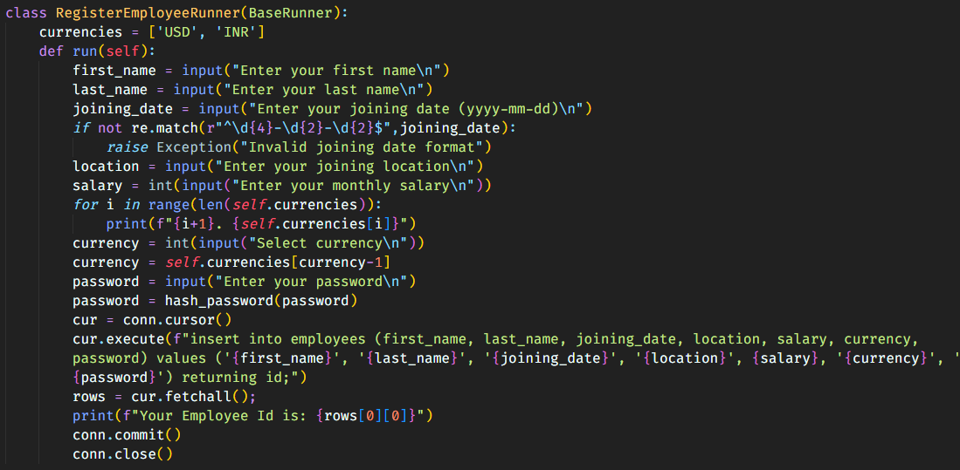

Slide 7
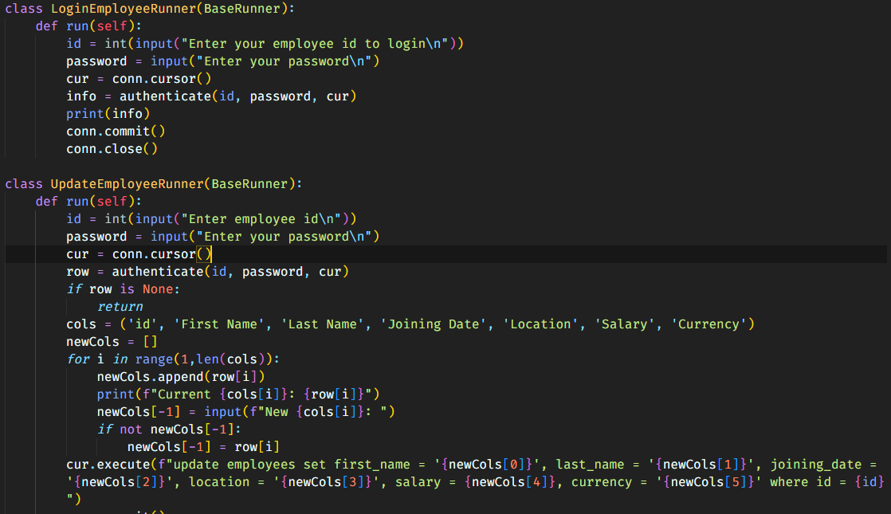

Slide 8
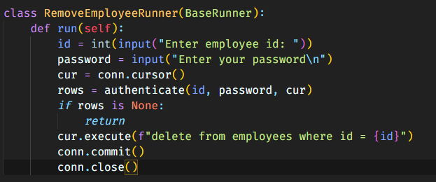

Slide 9
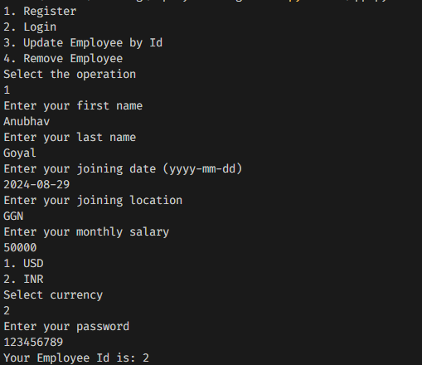
Output ScreenShots

Slide 10
Tech stack
Programming Language: Python
Database: PostgreSQL
Libraries: psycopg2 (postgres connector)

Slide 11
THANK YOU

